Slide 1


Lesson 11-1
The Recursion Theorem
Theory of Computation
王轩
Wang Xuan
Notes:
波斯特对应问题

Slide 2
Outline
Introduction
Self-Reference
The Recursion Theorem
Applications

Slide 3
Introduction
The recursion theorem is a mathematical result that plays an important role in advanced work in the theory of computability.
It has connections to mathematical logic, the theory of self-reproducing systems and even computer viruses.
Making machines that reproduce themselves is possible.

Slide 4
Outline
Introduction
Self-Reference
The Recursion Theorem
Applications

Slide 5
Self-Reference
Let’s begin by making a Turing machine SELF, that ignores its input and prints out a copy of its own description.
To help describe SELF, we need the following lemma.
Lemma:
  There is a computable function q: ∑*→∑*
  Where if w is any string, q(w) is the description of a Turing machine P_{w} that prints out w and halt.

Slide 6
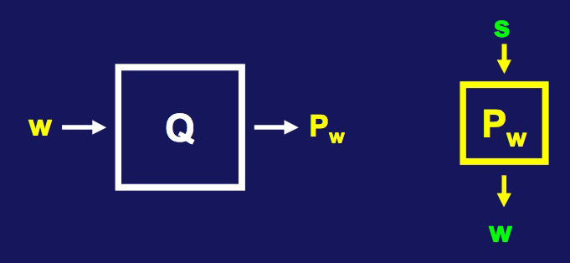
Self-Reference
The following TM Q computes q(w).
Q = “On input string w:
  1. Construct the following Turing machine P_{w}
      P_{w} = “On any input s:
        1. Erase input.
        2. Write w on tape.
        3. Halt.”
  2. Output <P_{w}>.”
<P_{w}> = q(w)

Slide 7
A TM That Prints Itself
Next we build a TM, SELF, that ignores its own input and prints out a copy of its description.
The Turing machine SELF is in two parts, A and B. We think of A and B as being two separate procedures that go together to make up SELF.

Slide 8
The TM SELF
Part A runs first and upon completion passes control to part B.
The job of A is to print a description of B on the tape ,hence A = P_{<B>}(P_{w} where w=<B>).
The job of B is to print out a description of A.
The tasks are similar, but are carried out differently.

Slide 9
For A we use the machine P_{<B>}, described by q(<B>).
q(<B>) means applying the function q to <B>.
Our description of A depends on having a description of B. So we can't complete the description of A until we construct B.

Slide 10
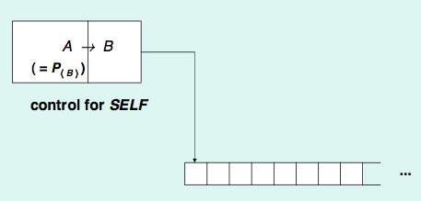
The TM SELF
If B can obtain <B>, it can apply q to that and obtain <A>.
What how can B obtain <B> ?
Well, it was printed on the tape, just before A passed control to B.
So, B computes q(<B>)=<A> and combines these and writes its own description <AB>.

Slide 11
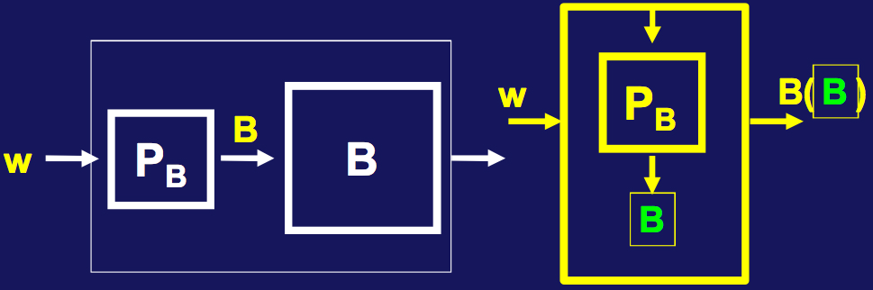
The TM SELF
A = P_{<B>}: A is the TM that prints out the description of B (But we do not have B yet!)
B = “On input <M> where M is a portion of a TM:
1. Compute q(<M>), (find the description of the machine which prints <M>)
2. Combine the result with <M> to make a complete TM.
3. Print the description of this TM and halt.”

Slide 12
How Self Behaves
1. First A runs. It prints <B>.
2. B starts. It looks at the tape and finds its input <B>.
3. B computes q(<B>) = <S> and combines that with <B> into a TM description <SELF>.
4. B prints this description and halts.

Slide 13
Outline
Introduction
Self-Reference
The Recursion Theorem
Applications

Slide 14
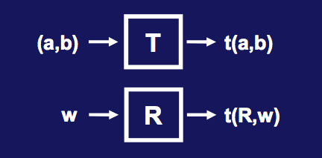
The Recursion Theorem
Let T be a TM that computes a function t: ∑*×∑*→∑*. There is a TM R that computes r, where for every w,
r (w) = t(<R>, w)

Slide 15
What is this Theorem saying?
Informally, a TM can obtain its own description and compute with it.
To make a TM, that can obtain its own description and then compute with it
1. Make a TM T that receives the description of itself as an extra input.
2. Then the recursion theorem produces a new machine, R which operates as T does, with R’s description filled in automatically.

Slide 16
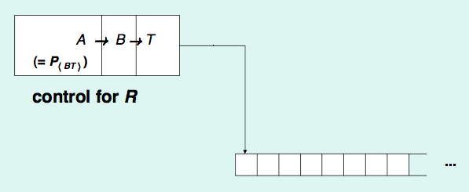
Proof Of The Recursion Theorem
We construct a machine with 3 parts: A,B and T.

Slide 17
Proof Of The Recursion Theorem
A is the TM P_{<BT>}, described by q(<BT>)
  Technical point: We redesign q so that P_{<BT>} writes its output following any preexisting string on the tape.
So, after A runs, the tape contains w<BT>
B examines the tape and applies q to <BT> getting <A>.
B then combines A, B and T into a single machine and obtains its description <ABT> = <R>
It encodes these as <R,w> and places it on the tape and passes the control to T.

Slide 18
Outline
Introduction
Self-Reference
The Recursion Theorem
Applications

Slide 19
Significance Of The Recursion Theorem
A_{TM} is undecidable.
Suppose H decides A_{TM}, we construct B:
B = “On input w:
  1 Obtain, via the recursion theorem, own description <B>.
  2 Run H on input <B,w>.
  3 Do the opposite of what H says.
      accept if H rejects.
      reject if H accepts.
B conflicts with itself – hence can not exist.
H can not exist.

Slide 20
A computer virus is a computer program that is designed to spread itself among computers. When placed appropriately in a host computer, computer viruses can become activated and transmit copies of themselves to other accessible machines.
In order to carry out its primary task of self-replication, a virus may contain the construction described in the proof of the recursion theorem.

Slide 21
Outline
Introduction
Self-Reference
The Recursion Theorem
Applications

